Slide 1
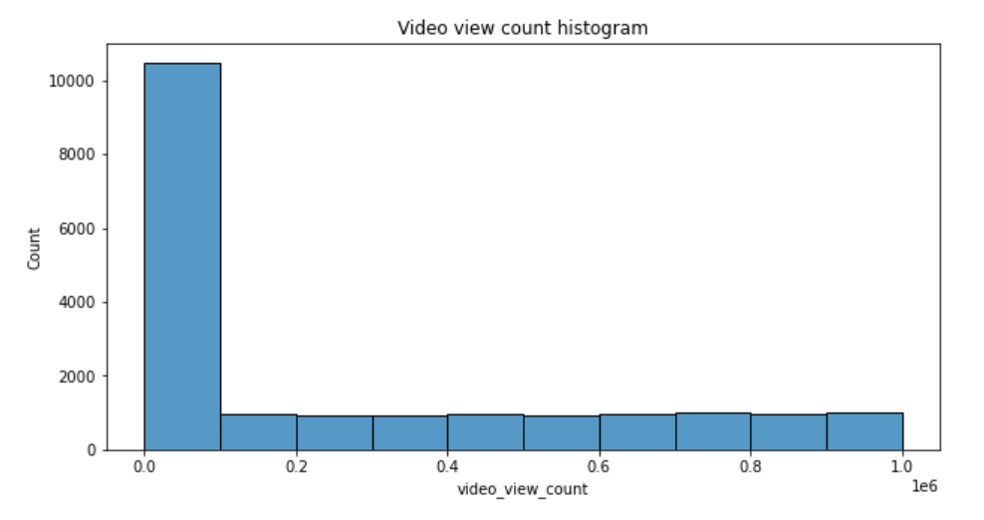
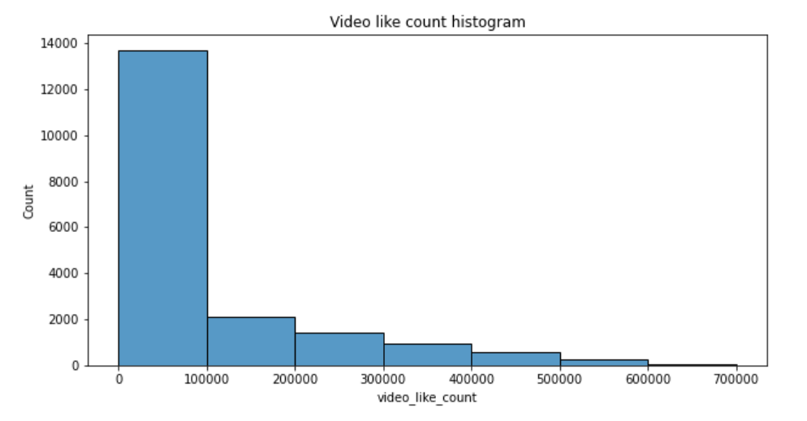
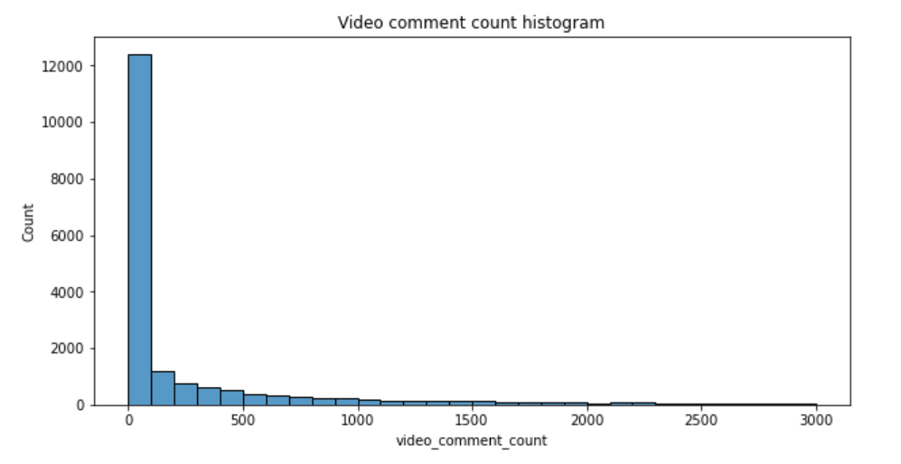
TikTok Claims Classification Project
Exploratory Data Analysis (EDA) - Executive Summary
Following 3 histograms shows us that, it is clear that the vast majority of videos are grouped at the bottom of the range of values for three variables that showcase TikTok users (video viewers’) engagement with the videos included in this dataset.
The TikTok leadership ask data team to develop a machine learning model to assist in the classification of claims for user submissions
In this part of the project, TikTok data team analyzed, explored, cleaned, and structured in order to build predictive model. TikTok data team also analyzed variables that would show user engagement, such as: view, like, and comment count.
From the exploratory data analysis shows that the future claim classification model will need to account for null values and imbalance in opinion video counts by considering these into the model parameters.
From these three histograms, video view, like, comment count, we understand that the view count variable has a very uneven distribution, and heavily skewed to the right.
The exploratory data analysis conducted from TikTok’s data team revealed many important factors for the classification model, such as: missing values, “claims” to “opinions” balance, and overall distribution of data variables. The two key insights from this analysis were:
Null values
Over 200 null values were found in 7 different columns. Future modeling should consider the null values to avoid making insights that would assume complete data. Further analysis is necessary to investigate the reason for these null values, and their impact on future statistical analysis or model building.
Skewed data distribution
The data distribution is heavily right-skewed, which will influence the model and model types that will be built.

